Slide 1

FckupFormat: Breaking JSON for Fun
A hackathon tale of chaos and comedy

Slide 2

Agenda
• Introduction & Challenge
• Design Principles
• Encoding Scheme
• Decoding Scheme
• Implementation & Code
• Example & Demo
• Process & Methodology
• Conclusion

Slide 3
Introduction & Challenge
The Fckupathon challenged us to invent a data format that's absurdly hard to read yet fully decodable.
The rules were simple: build an encoder and a decoder, support complex data, use any tech stack, and – most importantly – leave your teammates bewildered and laughing.

Slide 4
Design Principles
• Confuse on purpose: Every component – keys, types, values – is obfuscated through primes, base‑13, Caesar shifts, and emoji.
• Pop‑culture integration: Game of Thrones references, Valar phrases and dragons keep the mood light and meta.
• Barely decodable: All information is there – but recovering it without the spec will ruin your holiday.
• Language‑agnostic: The scheme works in any language, from Python to carrier pigeons.

Slide 5
Encoding Scheme
• An encoded object is enclosed in [ ] and consists of key‑value pairs separated by 🐉.
Base‑13 | Prime
0 | 2
1 | 3
2 | 5
3 | 7
4 | 11
5 | 13
6 | 17
7 | 19
8 | 23
9 | 29
10 | 31
11 | 37
12 | 41
• Each pair uses the format: <key>🔥<type>🌑<value>💀.
• Keys: convert each character to ASCII, then base‑13, then map digits to primes (see table).
• Type: use S,N,B,Z,O,A; shift each letter by +1 (S→T, N→O, …).

Slide 6
Value Encoding
• Strings: reverse, shift +1, Base64, reverse
• Integers: Roman numerals (XVI=16)
• Floats: Roman integer part ∙ Roman fraction
• Booleans: true→ValarMorghulis, false→ValarDohaeris
• Null: TheVoid
• Objects: recursively encode, reverse order
• Arrays: WinterIsComing + binary length + elements (type not stored)
[1]

Slide 7
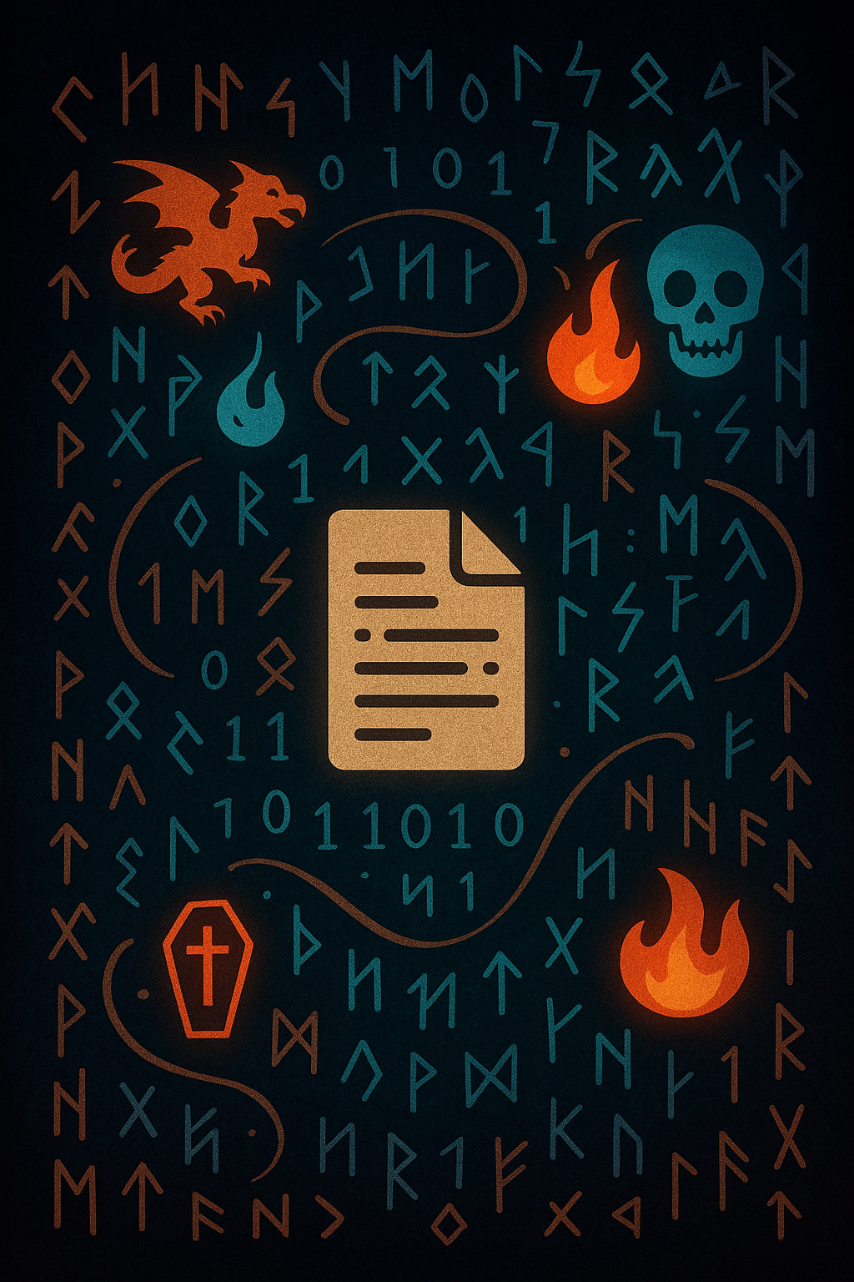
Implementation & Code
# Encode a key
def encode_key(key):
digits = []
for ch in key:
ascii_val = ord(ch)
base13 = to_base13(ascii_val)
primes = [digit_to_prime[d] for d in base13]
digits.append('-'.join(str(p) for p in primes))
return '.'.join(digits)
# Value encoding (simplified)
def encode_value(v):
if isinstance(v, str): return encode_string(v)
if v is None: return 'TheVoid'
if isinstance(v, bool): return 'ValarMorghulis' if v else 'ValarDohaeris'
if isinstance(v, int): return roman_encode(v)
if isinstance(v, float): return roman_float(v)
if isinstance(v, dict): return encode_object(v)
if isinstance(v, list): return encode_array(v)

Slide 8
Example & Demo
{ "name": "Arya", "age": 16, "isAssassin": true, "height": 1.55, "siblings": ["Sansa", "Bran"], "house": null }
[23-2.23-19.29-2.23-37.19-31🔥[🌑TheVoid💀🐉23-37.23-3.19-19.23-11.23-3.23-17.19-41.23-37🔥B🌑{WinterIsComing10|=QlYvRnY|==wQzJ2b}💀🐉23-2.19-31.23-3.19-41.23-2.23-41🔥O🌑I∙LV💀🐉23-3.23-37.13-2.23-37.23-37.19-17.23-37.23-37.23-3.23-17🔥C🌑ValarMorghulis💀🐉19-17.19-41.19-31🔥O🌑XVI💀🐉23-17.19-17.23-13.19-31🔥T🌑==gQzpnY💀]
Decoding this monstrosity brings back the original JSON structure — and a newfound appreciation for well‑designed standards.

Slide 9
Process & Methodology
1. Decode the Challenge: Read the hackathon brief and laugh nervously.
2. Brainstorm & Design: Drafted principles: confusion, pop culture, decodability.
3. Research & Reference: Pulled memes and Roman numeral facts
4. Build & Test: Implemented encoder/decoder in Python and tested with sample data.
5. Create Fun Visuals: Generated whimsical art of dragons & cats using AI.
6. Craft the Presentation: Assembled slides with humour, tables and examples.

Slide 10
Conclusion
We delivered a working, wildly non‑standard data format that is as entertaining to read as it is awful to debug.
By hiding keys behind prime numbers, disguising values with Roman numerals and Valar phrases, and neglecting type information in arrays, FckupFormat guarantees confusion and laughter in equal measure.
Remember: there’s a decoder – but please don’t write any documentation. Let your colleagues experience the madness!

